Slide 1
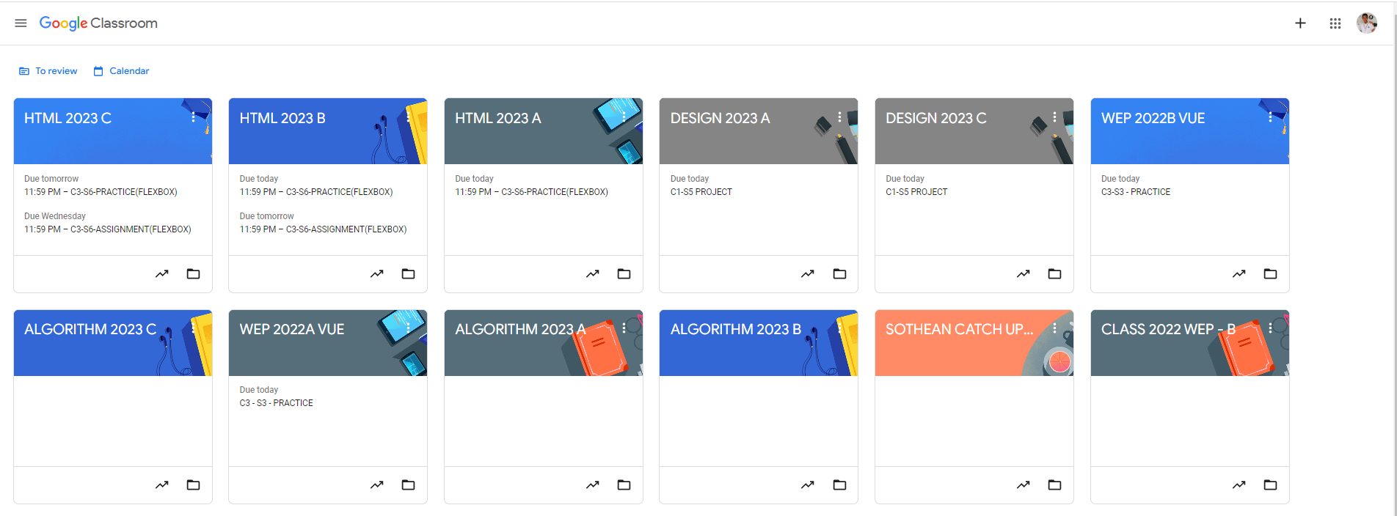
Identify root components of website below

Slide 2
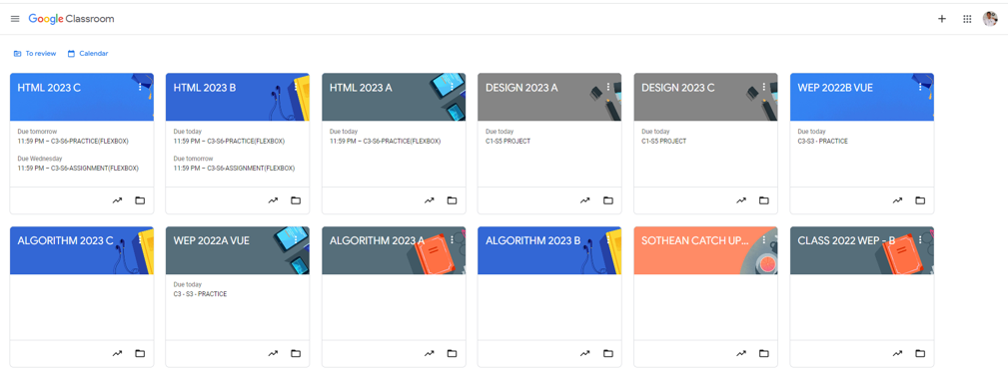
Identify the div structure for root
Root: Height: 100vh
nav
content
Flex: 0
header
Flex: 0
Flex: 1

Slide 3
Identify the div structure for Navigation
Flex:1
Flex:1
nav-left
nav-right

Slide 4
Navigation
nav-left
Nav-right
icon
logo
icon
icon
icon
display: flex;
justify-content : flex-start: flex-start
display: flex;
justify-content : flex-end: flex-start

Slide 5
Identify the div structure for Header
div 1
div 2

Slide 6
Identify the div structure for Header
icon
text
icon
text

Slide 7
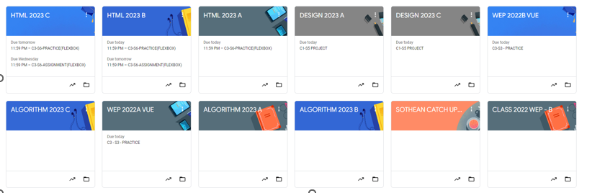
Identify the div structure for Container

Slide 8
Main | Container
Card 1
Card 2
Card 3
Card 4
Card 5
Card 6
Card 7
Card 8
Card 9
Card 10
Card 11
Card 12

Slide 9

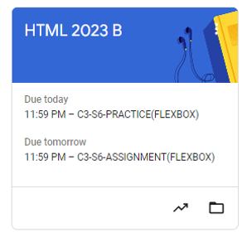
Card
Card-header
Flex 1.5
Card-body
Flex 2
Card-footer
Flex 1

Slide 10
Card
Image | background-image
justify-content : space-between;
align-items : flex-start;t
Card-title
icon
Card-header
flex-direction : column;
justify-content :center;
align-items : center;
Card-Content
Card-body
Card-Content
justify-content :flex-end
icon
icon
Card-footer

